Slide 1
W5-2
Data in HTML

Slide 2
Step 1 (10 Minutes)
Make sure the PostgreSQL database is installed and running: Students should have installed PostgreSQL and the database service is running.
Create the database and tables: Use the provided SQL statements to create the market and info tables (if have not been created yet).
Insert sample data: Insert sample data into the market and info tables for querying and display purposes.

Slide 3
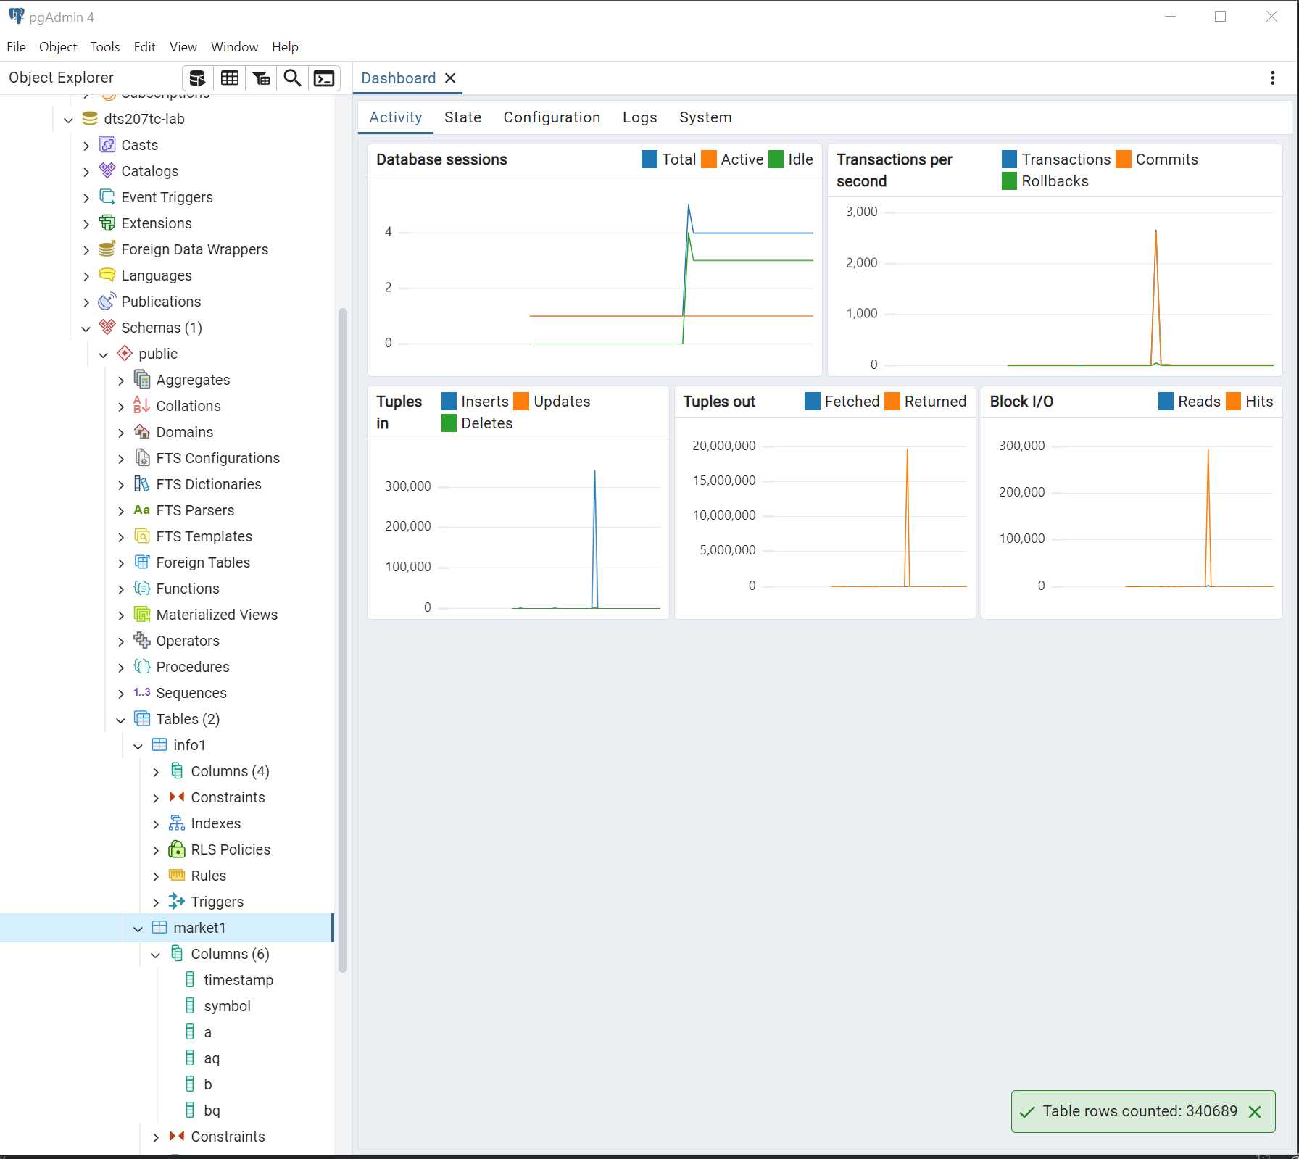

Slide 4
Step 2 (10 Minutes)
Write a SQL query to retrieve the latest market information of a specific trading pair (such as ETH/BTC) from the market table.
SELECT * FROM public.market
WHERE symbol = 'EYCU'
ORDER BY t_ DESC
LIMIT 1;

Slide 5
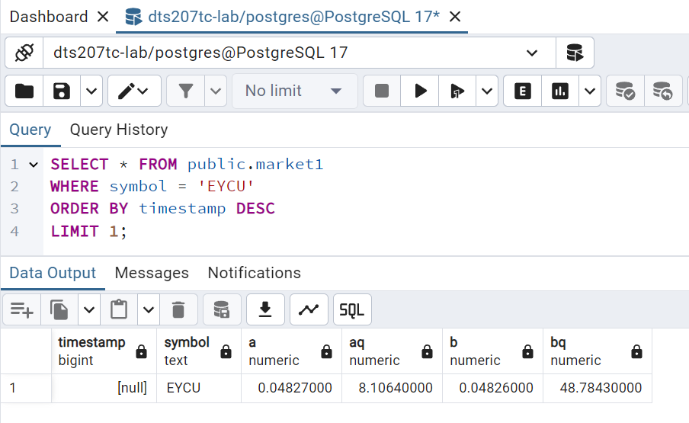

Slide 6

Step 2 (10 Minutes)
Write a SQL query to retrieve the base and denominated currency information of a specific trading pair from the info table.
SELECT base, quote_ FROM public.info
WHERE symbol = 'EYCU';

Slide 7
Step 3 (30 Minutes)
Create a new HTML file named market_data.html.
Add the infrastructure to the HTML file, including <!DOCTYPE html>, <html>, <head>, and <body> tags.
Within the <body> tag, add an HTML table to display the market information retrieved from the database.

Slide 8
Step 3 (30 Minutes)
Add JavaScript code to the HTML file to retrieve data from the database asynchronously and fill the data into the HTML table.
Note: Since this is a simplified experiment, we can use static JavaScript code to simulate the process of retrieving data from the database. In actual applications, this is usually implemented through backend services (such as Node.js, PHP, Python Flask, etc.) and AJAX requests. But here, for simplicity, we can embed simulated data directly in the JavaScript code.
The following is a simplified HTML and JavaScript code example:

Slide 9
<!DOCTYPE html>
<htmllang="en">
<head>
<metacharset="UTF-8">
<metaname="viewport"content="width=device-width, initial-scale=1.0">
<title>Market Data</title>
</head>
<body>
<h1>Market Data for BTC/ETH</h1>
<table border="1">
<tr>
<th>Symbol</th>
<th>Best Sell Price</th>
<th>Best Sell Quantity</th>
<th>Best Buy Price</th>
<th>Best Buy Quantity</th>
<th>Base Currency</th>
<th>Quote Currency</th>
</tr>
<tr id="market-data-row">
<!-- Data will be populated here by JavaScript -->
</tr>
</table>

Slide 10
<script>
// Simulated AJAX request to fetch data from backend
// In a real-world scenario, this would be replaced with an actual AJAX call
setTimeout(function() {
// Simulated data received from backend
var data = {
symbol: 'EYCU',
a: 10000,
aq: 1.5,
b: 9999,
bq: 2.0,
base: 'EY',
quote_: 'CU'
};
// Populate the table with the received data
var row = document.getElementById('market-data-row');
row.innerHTML= `
<td>${data.symbol}</td>
<td>${data.a}</td>
<td>${data.aq}</td>
<td>${data.b}</td>
<td>${data.bq}</td>
<td>${data.base}</td>
<td>${data.quote_}</td>
`;
}, 1000); // Simulate a 1-second delay for loading data
</script>
</body>
</html>

Slide 11
<script>
// Simulated AJAX request to fetch data from backend
// In a real-world scenario, this would be replaced with an actual AJAX call
setTimeout(function() {
// Simulated data received from backend
var data = {
symbol: 'EYCU',
a: 10000,
aq: 1.5,
b: 9999,
bq: 2.0,
base: 'EY',
quote_: 'CU'
};
// Populate the table with the received data
var row = document.getElementById('market-data-row');
row.innerHTML= `
<td>${data.symbol}</td>
<td>${data.a}</td>
<td>${data.aq}</td>
<td>${data.b}</td>
<td>${data.bq}</td>
<td>${data.base}</td>
<td>${data.quote_}</td>
`;
}, 1000); // Simulate a 1-second delay for loading data
</script>
</body>
</html>

Slide 12
Step 4 (10 Minutes)
Open the market_data.html file, display the page in the browser, and wait for the data to load.
Understand how to retrieve data from the database, how to display data in HTML, and how to use JavaScript to implement asynchronous data loading.

Slide 13
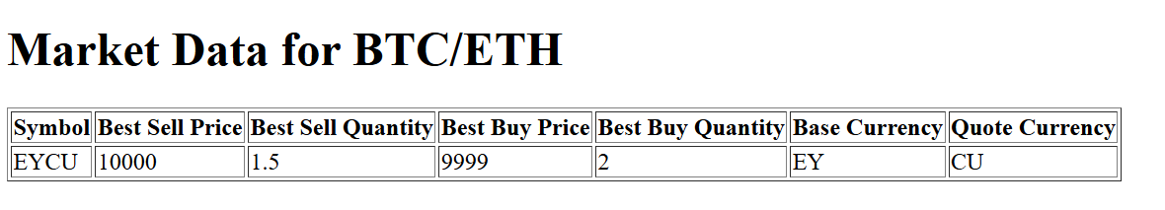

Slide 14
One More Thing
As the preparation for Lab 6, please download and install Ubuntu in VirtualBox before the start of Lab 6 to ensure you have enough time for Hadoop practice.
You can download the Ubuntu ISO from BOX link: https://box.xjtlu.edu.cn/d/99367a125ef4460a90ec/
See Lab6.pptx for more details.

